Slide 1
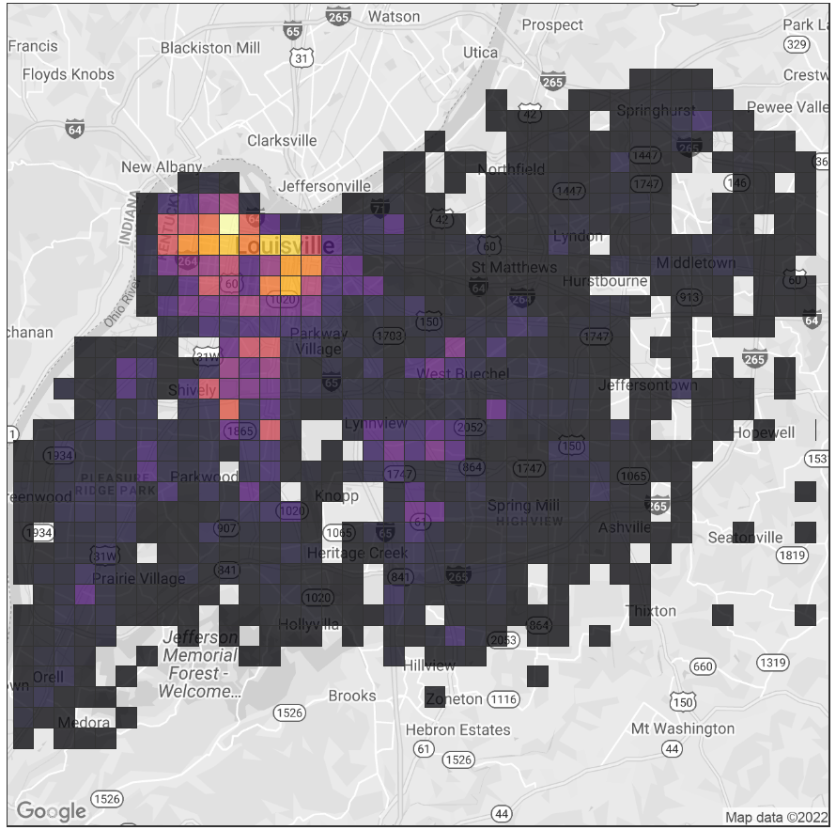

Understanding Louisville Metro Crime Through the Lens of Funding.
Team Members:
Preethi Mahankali
Richard Castaneda
Shailaja Bommena
Tamanna Fatima Syeda

Slide 2

Introduction:
The goal of this project is to investigate the relationship between two important datasets, "Louisville's Funds Report" and "Louisville Metro Crime Rates from 2017–2021," through an interdisciplinary journey.
Data Sources:
August 28th was used to acquire data on crime rates, and September 11th was used to collect data on funds. Both datasets were retrieved from https://data.louisvilleky.gov/.
Project Significance:
The significance of this project lies in the dataset's ability to function as corpora that encode the intricate relationships between social safety and public spending, providing information on how funding changes crime rates.
Dataset Dimensions:
306,634 rows and 9 variables make up the "Louisville Metro Crime Rates" dataset, whereas 6 rows and 19 variables make up the "Louisville's Fund Report."
PROJECT
OVERVIEW

Slide 3
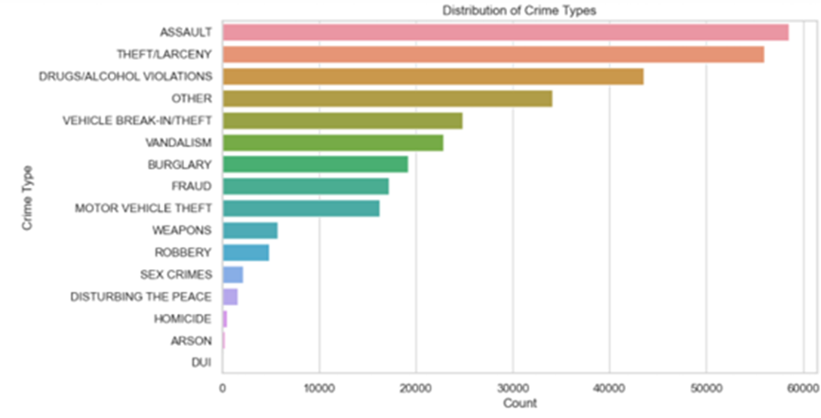

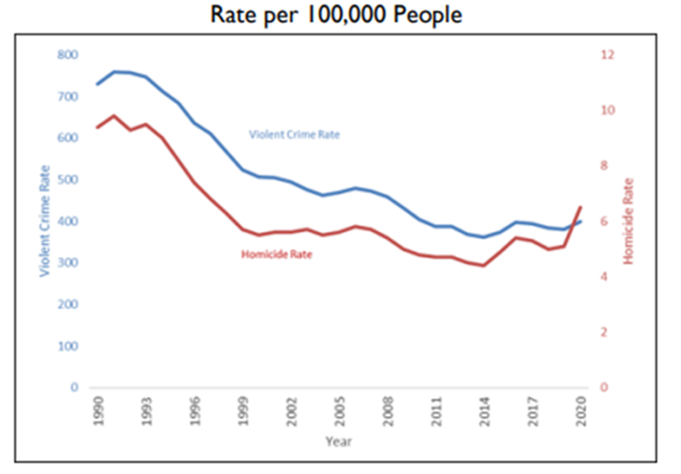
Distribution of Crime Types
DUI (driving under the influence) had the fewest occurrences of any crime, while ASSAULT had the most occurrences overall, according to the distribution of crime types.
EDA
Crime Rates from 1990- 2021.
Recent FBI analysis indicates a marginal decrease in violent crimes and an increase in homicides for 2020-2021, suggesting relative stability in crime rates."

Slide 4


How does the allocation of various types of public safety funding relate to distinct categories of crime rates?
How do temporal patterns influence the prevalence of crime, with a focus on the variation across seasons, the incidence during holidays, and the fluctuation throughout the days of the week?
Is there a time lag between the allocation of funds and its effect on crime rates?
Are there lower crime rates in areas receiving more funding?
RESEARCH QUESTIONS

Slide 5
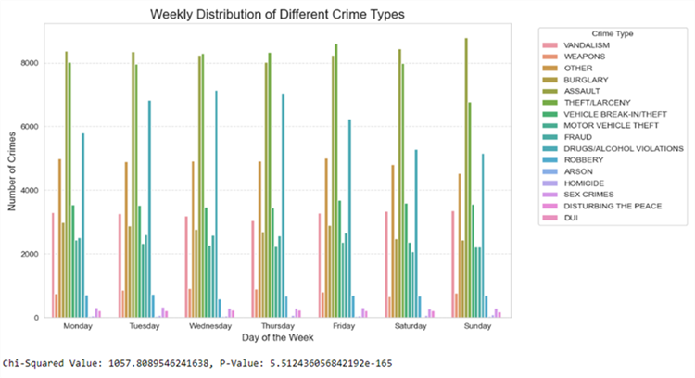

Correlation Between Total Funding and Total Expenditure
MODELING​
Weekly
Distribution

Slide 6
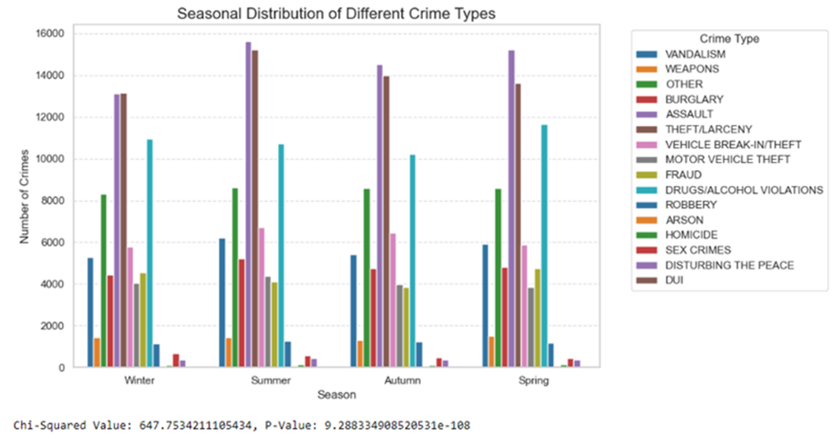
Correlation Between Total Funding and Total Expenditure
MODELING​
Seasonal
Distribution

Slide 7
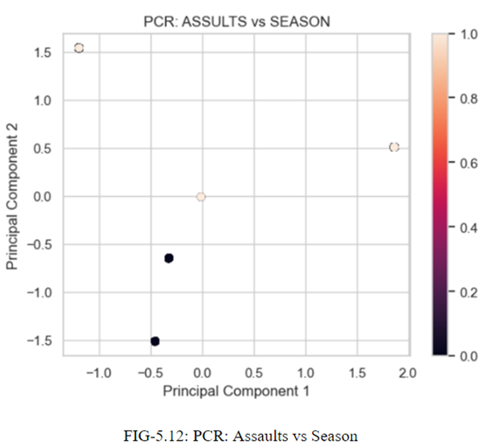
Correlation Between Total Funding and Total Expenditure
MODELING​

Slide 8
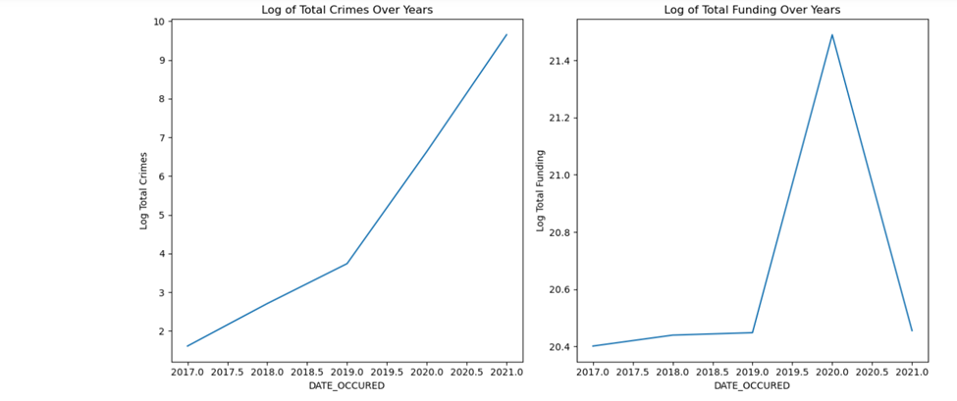
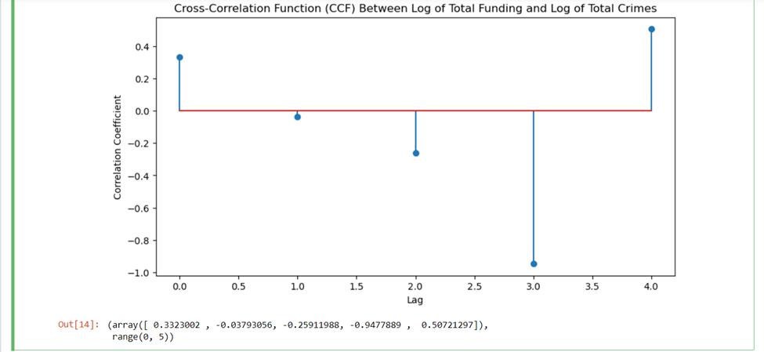
Log of Total Crimes over years with Date Occurred.
EXPLORATORY
DATA
ANALYSIS
At lag 0, funding and crime rates show a significant positive correlation, indicating their direct and simultaneous relationship. Negative correlations at lags 1 and 2, and a strong negative correlation at lag 3, suggest a delayed yet pronounced inverse impact of funding on crime, becoming significant three time units later.
EDA
The above-left graph shows a steady increase in total crimes from the year 2017 to 2021. The right graph shows relatively stable funding from 2017 to just before 2020 and there is a spike around 2020. The spike represents a one-time increase in funding.

Slide 9
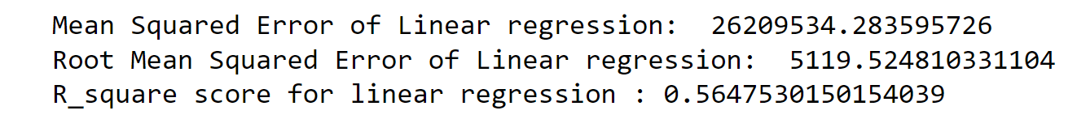
​
Is there a time lag between the allocation of funds and its effect on crime rates?
EXPLORATORY
DATA
ANALYSIS
Linear Regression Output
MODELING​
The high Mean Squared Error (MSE) of this model indicates a significant discrepancy between predicted and actual crime rates, with an RMSE of 5119 suggesting a notable average deviation. This level of error is concerning, especially if crime counts are typically lower than tens of thousands. Despite an R2 value of 0.565, which implies moderate predictive capability, the overall accuracy is poor, leading to the consideration of an alternative model, such as the Random Forest Model, for more reliable predictions.

Slide 10
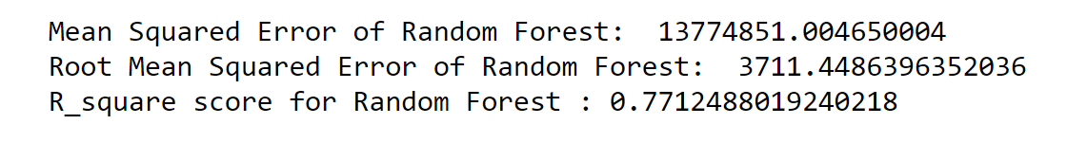
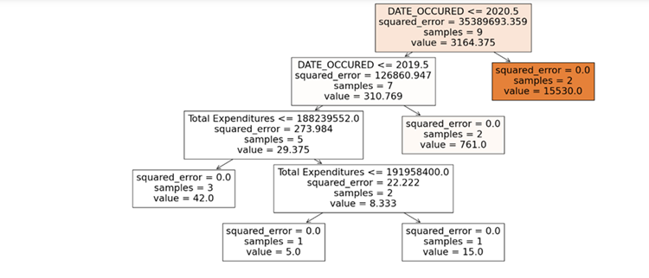
Random Forest Classifier Output
EXPLORATORY
DATA
ANALYSIS
MODELING​
To investigate whether areas with more funding have lower crime rates, a decision tree analysis using total expenditures as the key decision node was first conducted on two datasets, one on funding and the other on crime, revealing a perfect fit in the training set but higher errors at the root node. This initial analysis was followed by a linear regression to further assess the relationship between funding levels and crime rates.

Slide 11
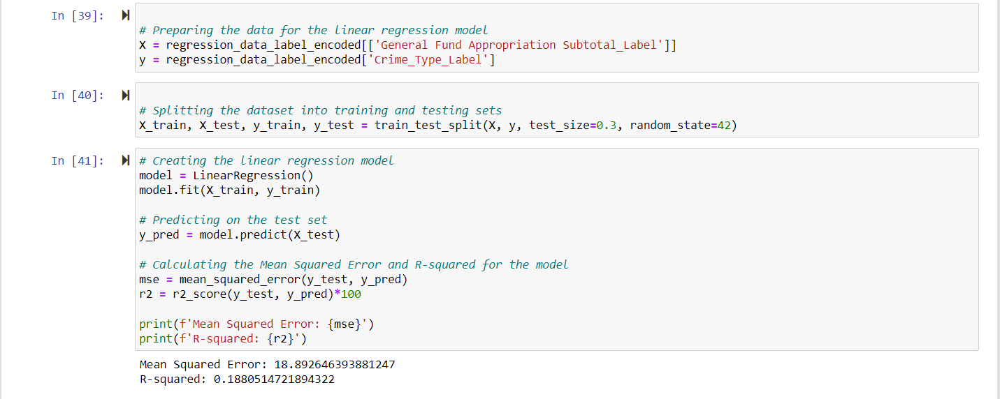
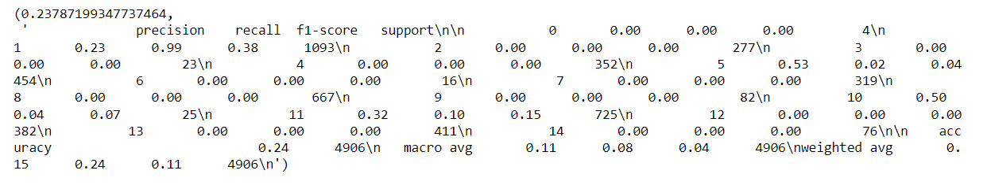
How does the allocation of various types of public safety funding relate to distinct categories of crime rates?
Linear Regression Output
MODELING​
Random Forest Classifier Output
A low MSE but poor R-square value, indicating suboptimal model fit. So applied the Random Forest algorithm with different variables, including Total Funding and Year, which yielded better F1-scores but inadequate precision, suggesting the model's limited effectiveness. Comparing both models, Linear Regression showed slightly better performance, but neither model conclusively demonstrated a strong link between funding and crime.

Slide 12
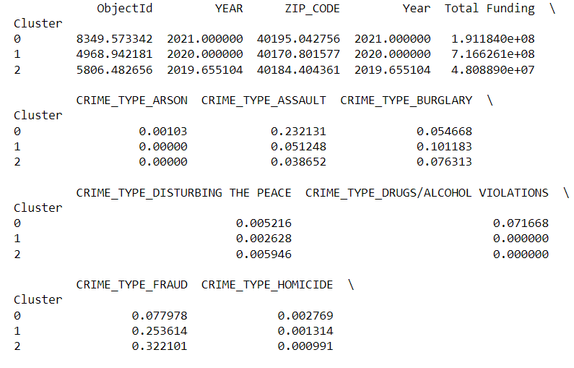
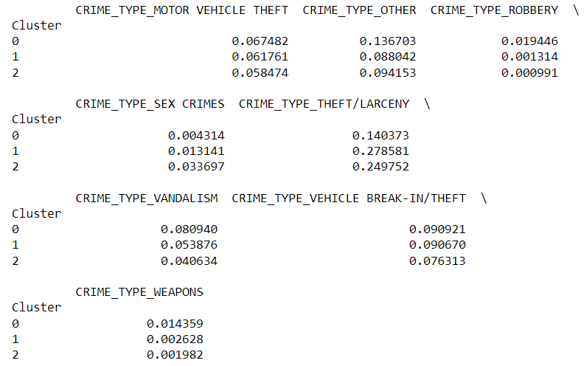
K-Means Clustering Output.
Silhouette Score.
MODELING​
As the other two models weren't well, went ahead and did clustering analysis which had a good Silhouette Score showing that the model is good fit. Then we did Categorization Standard Deviation from which we can say that before and after funding rates of assaults, disturbing the peace, homicides, and sex crimes increased, while other crimes decreased.

Slide 13
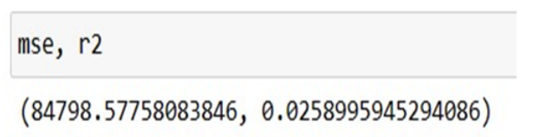
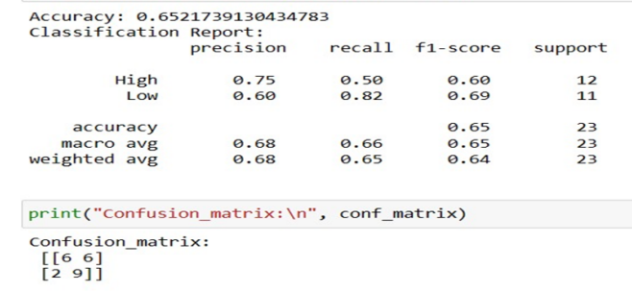
Are there lower crime rates in areas receiving more funding?
Linear Regression Output
Mean squared Error (MSE) is 84798.577 and R-square value is 0.0258. The MSE value is very high, which suggests that the model is not a better fit for the data. 0.025 value of R- Square explains that only 2.5% of the variability in the crime counts, which is very low.
MODELING
Logistic Regression Output:
The logistic regression achieved an accuracy of 65.2%.

Slide 14
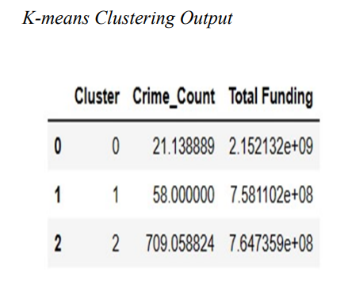
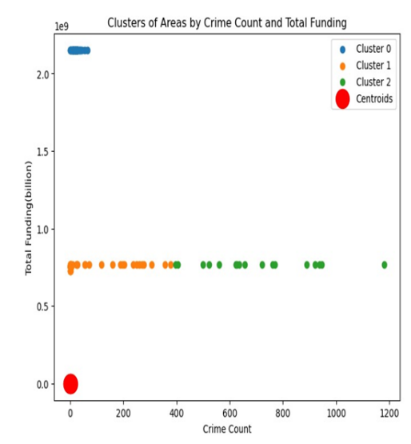

Clustering Algorithm (K-Means):
MODELING
The lowest crime rates are seen in Cluster 0, which has the most funding, indicating that a higher funding level may be linked to a lower crime rate. Nonetheless, Clusters 1 and 2 had notably different crime rates despite receiving comparable financing, suggesting that variables other than funding may have a big impact on crime rates

Slide 15

How does the allocation of various types of public safety funding relate to distinct categories of crime rates?
To assess the impact of public safety funding on crime rates, the analysis considered various crimes (assault, sex crimes, homicides, etc.) and compared crime rates before and after funding. The conclusion indicates a general reduction in crime rates linked to increased funding, affirming a relationship between crime rates and funds. So moving forward, we recommend policy implementation focused on crime reduction, and we anticipate analyzing the subsequent impact on decreasing crime rates.
CONCLUSION
Is there a time lag between the allocation of funds and its effect on crime rates?​
The analysis reveals that the most significant impact on crime rates occurs when there's a temporal lag between funding allocation and its effects, highlighting the importance of considering these delays in policy making. While immediate outcomes of increased funding may be limited, the long-term effects are more substantial in reducing crime. This study underscores the effectiveness of advanced predictive models like Random Forest in understanding and forecasting these complex relationships between funding allocation and crime rate changes.

Slide 16
How do temporal patterns influence the prevalence of crime, with a focus on the variation across seasons, the incidence during holidays, and the fluctuation throughout the days of the week?
In our study, three Chi-Squared tests provided insightful revelations about the relationship between crime types and time-related factors like seasons, weekdays, and holidays. These tests showed significant variations in crime distribution, which are critical for law enforcement agencies in formulating targeted strategies. The visual analysis of weekly crime trends highlighted consistent patterns, such as the prevalence of 'THEFT/LARCENY', increased 'DRUGS/ALCOHOL VIOLATIONS' on weekends, a midweek surge in 'FRAUD', and a rise in 'DUI' towards the weekend. Seasonally, assault cases were notably higher in the summer, suggesting a link to social activities and warmer temperatures. The PCA plot provided a simplified view of these complex relationships, pointing to key factors influencing seasonal assault occurrences, although further in-depth analysis is necessary for definitive conclusions.
These findings highlight the importance of considering temporal aspects in crime prevention and public safety planning Incorporate Socioeconomic and Demographic Data in future research could deepen this understanding and enhance the effectiveness of crime prevention strategies.
CONCLUSION

Slide 17
Are there lower crime rates in areas receiving more funding?
Funding is a significant but not the only element determining crime rates, as evidenced by the difference in model performances and cluster patterns. The uneven effects of funding on crime rates among various clusters emphasizes the significance of considering additional contextual elements, including but not limited to socioeconomic conditions, the effectiveness of law enforcement, and community involvement measures. Accurate data that accurately link socioeconomic factors to crime rates should be the goal of future research. The intricate relationship between funding and crime may be revealed by sophisticated statistical techniques and sophisticated models, which could lead to more intelligent resource allocation.
CONCLUSION

